Slide 1

Unity 3D Essentials
Unity Basics
SoftUni Team
Technical Trainers
Software University
https://softuni.org

Slide 2
Table of Contents
What is Unity?
Coordinate System
Cameras
Lights, Shadows, Shaders and Materials
Game Objects and Components
Scene, Hierarchy and Assets
Interface
MonoBehaviour basics
2
Notes:
2

Slide 3
Have a Question?
sli.do
#Unity3D-Basics
Notes:
3

Slide 4

What is Unity?

Slide 5
What is Unity 3D?
Multi-platform Game Engine (https://www.unity3d.com)
Supported Languages - C# (+ JS and Boo in the past)
Backend
Mono (https://www.mono.project.com)
IL2CPP (https://www.docs.unity3d.com/Manual/IL2CPP.html)
Unity 3D version used - 2019.3
Link - unityhub://2019.3.13f1/d4ddf0d95db9
What is Unity Hub?

Slide 6

Coordinate System

Slide 7
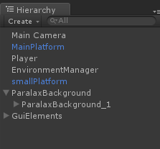
Coordinate System
Cartesian coordinate system (Vector 3)
Local and world position (child/parent)
Rotation (Euler/Quaternion)

Slide 8


Cameras

Slide 9
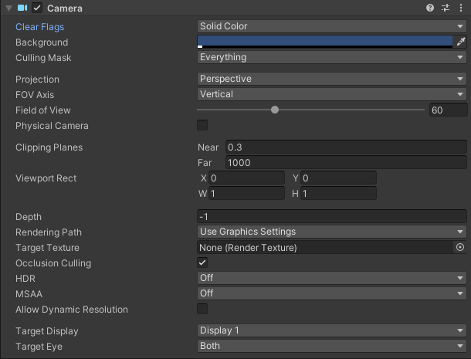
Cameras
Defines what player see
Properties
Multiple cameras

Slide 10

Lights and Shadows

Slide 11
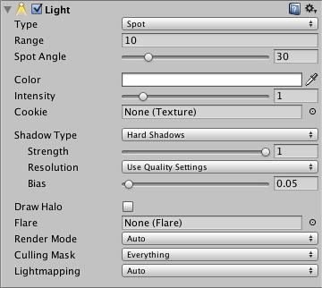
Lights and Shadows
Lights types
Shadow types
Performance/Baking
Quality Settings

Slide 12


Shaders and Materials

Slide 13
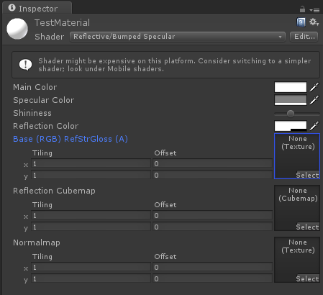
Shaders and Materials
Shaders
Materials

Slide 14

Game Objects and Components

Slide 15
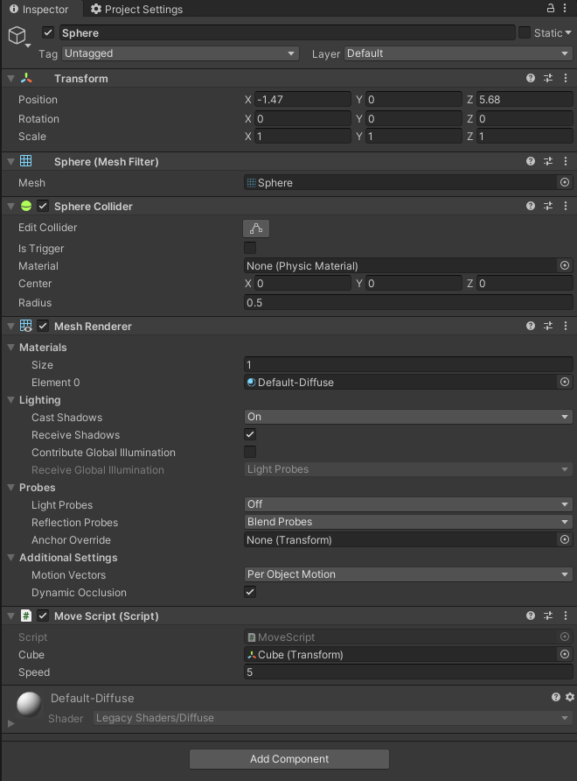

Game Objects and Components
What is Game Object
MonoBehaviour
Components

Slide 16


Scene, Hierarchy and Assets

Slide 17
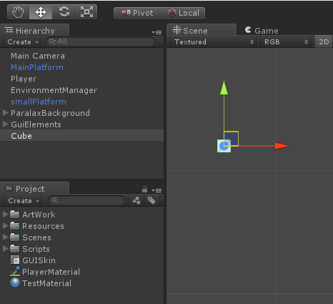
Scene, Hierarchy and Assets
Parent/Child relation
Scene hierarchy
Assets hierarchy

Slide 18

Interface

Slide 19
Interface
Scene
Game
Inspector
Hierarchy
Project
Console
Animation
Animator
Asset Store

Slide 20

MonoBehaviour basics

Slide 21
MonoBehaviour Basics
FixedUpdate, Update, LateUpdate
Awake and Start
OnEnable and OnDisable

Slide 22
MonoBehaviour Basics
Transform
Translate() - Transform.Translate(X,Y,Z) - move the GO
Rotate() - Transform.Rotate(X,Y,Z) - rotate to GO
LocalScale - Transform.localScale = Vector3.One

Slide 23
MonoBehaviour Basics
Activate/Deactivate Game Object
FixedUpdate, Update, Late Update won’t be called
Destroy
Removes it from the scene
OnDestroy callback gets called
Capture Input
Input.GetKey(KeyCode.A)
KeyCode - enum for different keys

Slide 24

Our First Game
Lab

Slide 25
Our First Game
How to follow an object based on distance
// Update is called once per frame
void LateUpdate ()
{
if (sphere != null)
{
this.transform.LookAt(sphere);
if (Vector3.Distance(this.transform.position, sphere.position) > minDistance)
{
this.transform.Translate(0f, 0f, followSpeed * Time.deltaTime);
}
}
}

Slide 26
Our First Game
How to move an object via keyboard
void Update ()
{
if (Input.GetKey(KeyCode.UpArrow))
{
this.transform.Translate(0f, 0f, speed * Time.deltaTime);
}
else if (Input.GetKey(KeyCode.DownArrow))
{
this.transform.Translate(0f, 0f, speed * -1 * Time.deltaTime);
}
}

Slide 27
Useful Links
http://www.docs.unity3d.com/Manual
https://www.docs.unity3d.com/ScriptReference
https://unity3d.com/learn/tutorials/modules

Slide 28

Summary
What is Unity?
Coordinate System
Cameras
Lights, Shadows, Shaders and Materials
Game Objects and Components
Scene, Hierarchy and Assets
Interface
MonoBehaviour basics
Notes:
28

Slide 29
Questions?
Notes:
29

Slide 30











SoftUni Diamond Partners
30
Notes:
30

Slide 31



Educational Partners
31
Notes:
31

Slide 32

License
This course (slides, examples, demos, exercises, homework, documents, videos and other assets) is copyrighted content
Unauthorized copy, reproduction or use is illegal
© SoftUni – https://about.softuni.bg
© Software University – https://softuni.bg
Notes:
32

Slide 33
Trainings @ Software University (SoftUni)
Software University – High-Quality Education, Profession and Job for Software Developers
about.softuni.bg, softuni.org
Software University Foundation
softuni.foundation
Software University @ Facebook
facebook.com/SoftwareUniversity
Software University Forums
forum.softuni.bg
Notes:
33

